Slide 1
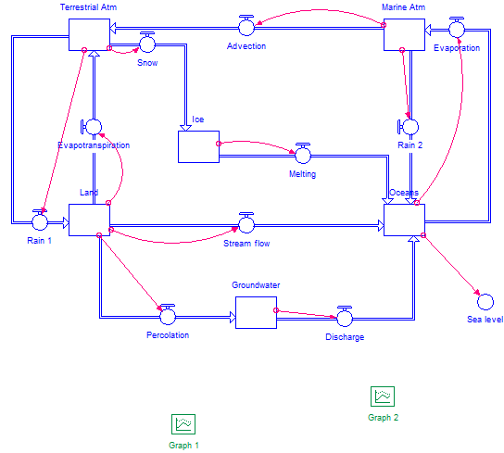
Initial model

Slide 2
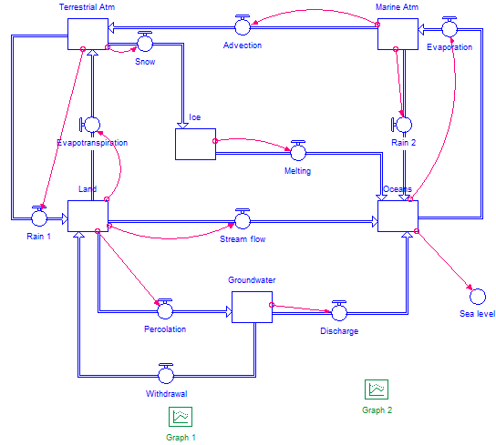
Experiment 1a: Groundwater mining

Slide 3
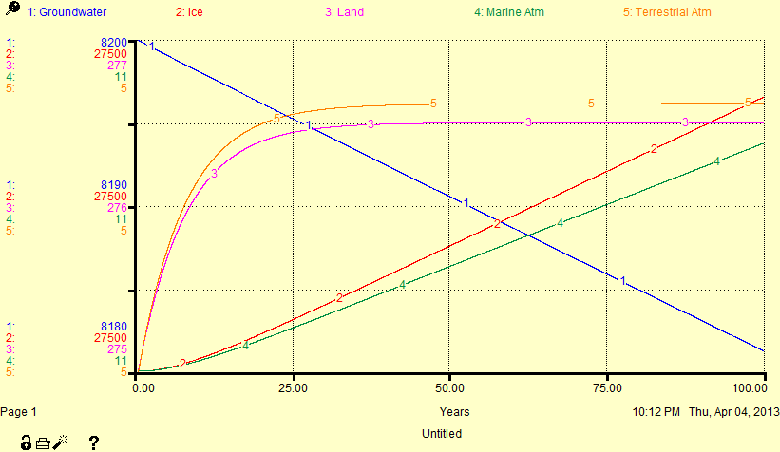
Experiment 1a: Groundwater mining

Slide 4
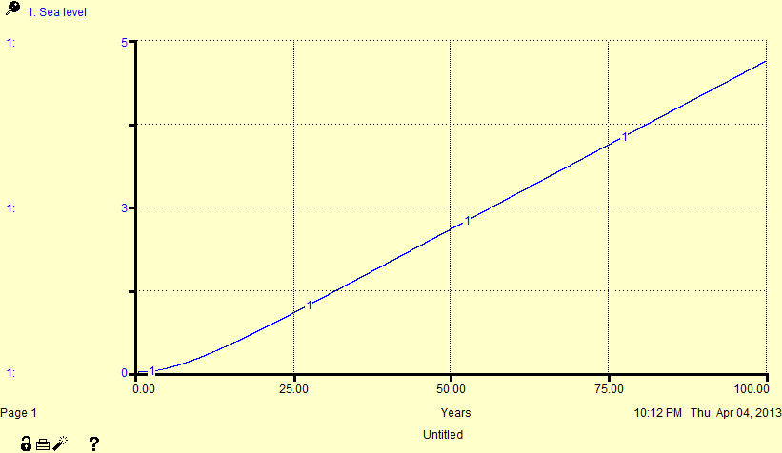
Experiment 1a: Groundwater mining

Slide 5
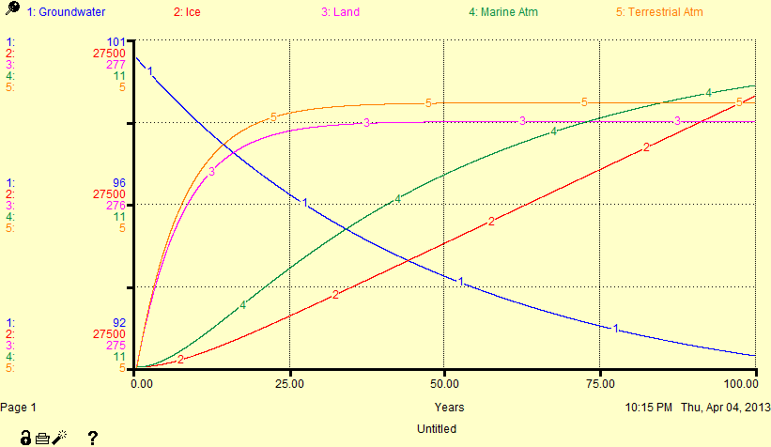
Experiment 1a: Smaller groundwater reservoir

Slide 6
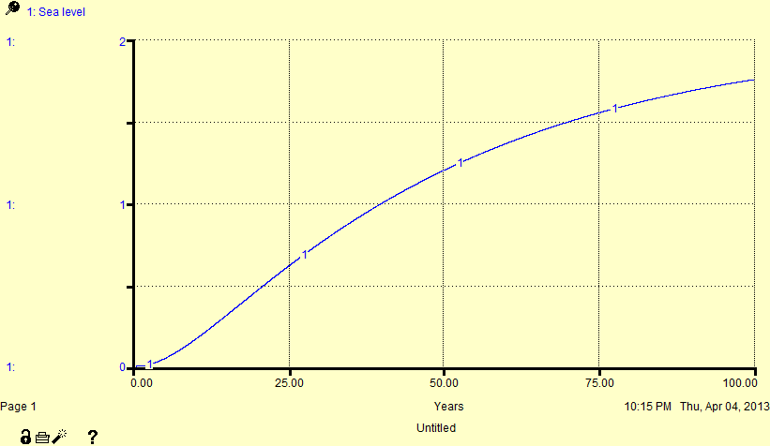
Experiment 1a: Smaller groundwater reservoir

Slide 7
Experiment 1b: Irrigation
Reduce stream flow

Slide 8
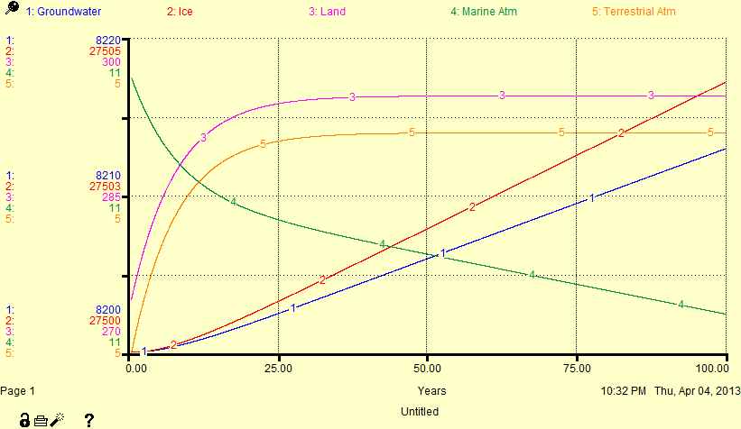
Experiment 1b: Irrigation

Slide 9
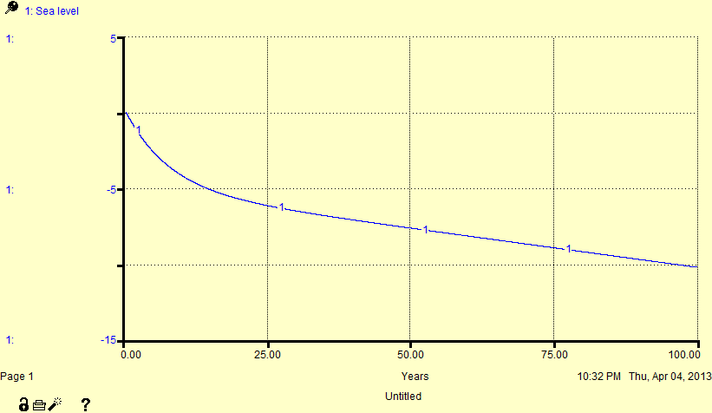
Exercise 1b: Irrigation

Slide 10
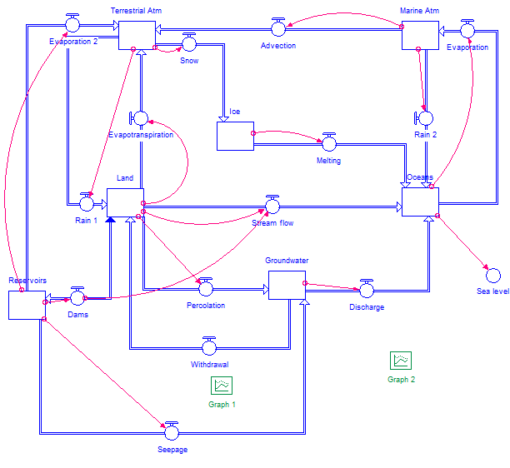
Experiment 1c: Building dams

Slide 11
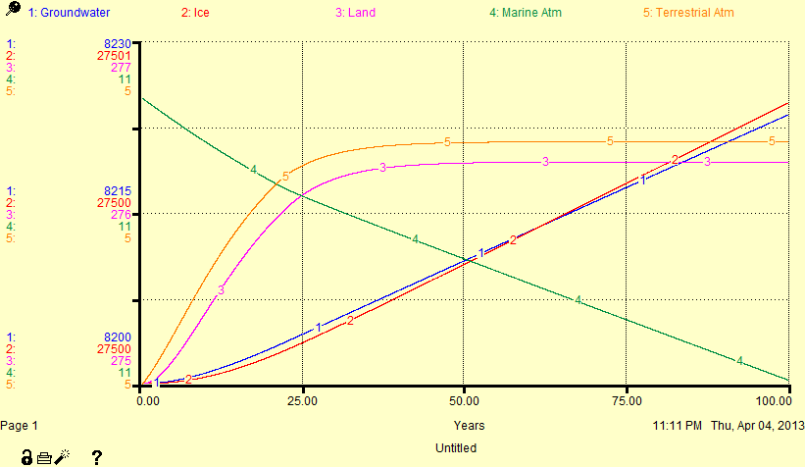
Experiment 1c: Building dams

Slide 12
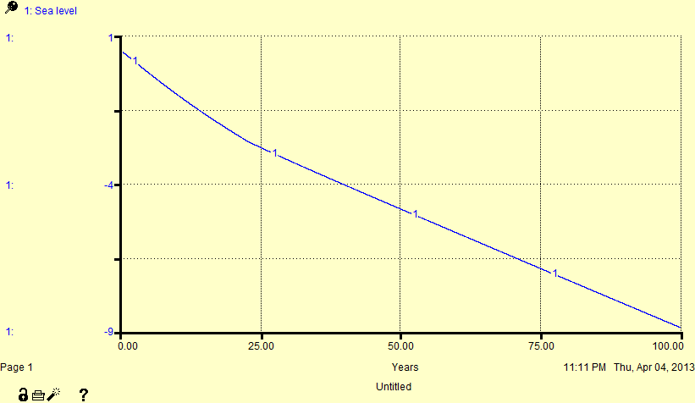
Experiment 1c: Building dams

Slide 13
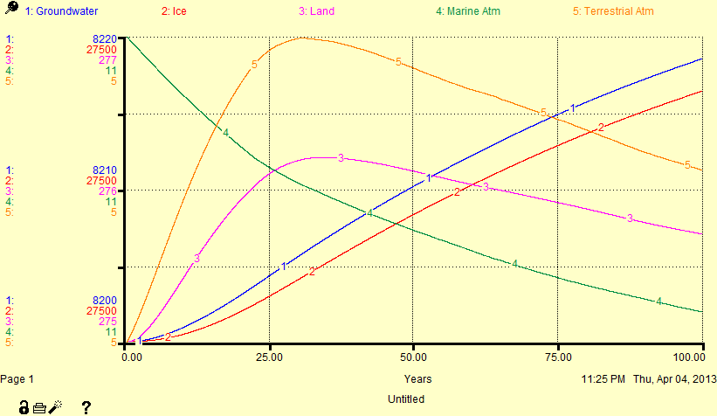
Experiment 1c: Building dams and including sedimentation

Slide 14
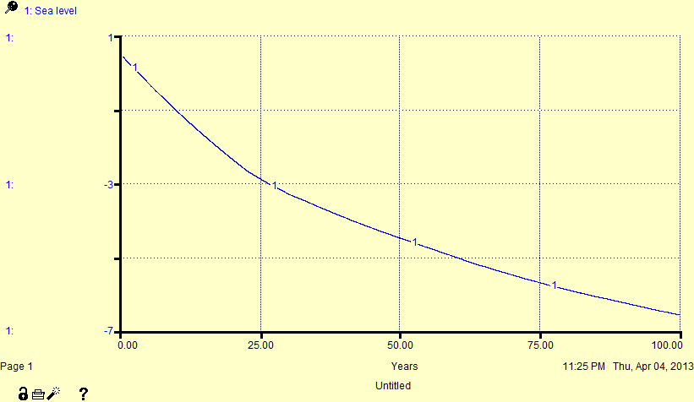
Experiment 1c: Building dams and including sedimentation

Slide 15
Experiment 1d: “All” human impacts

Slide 16
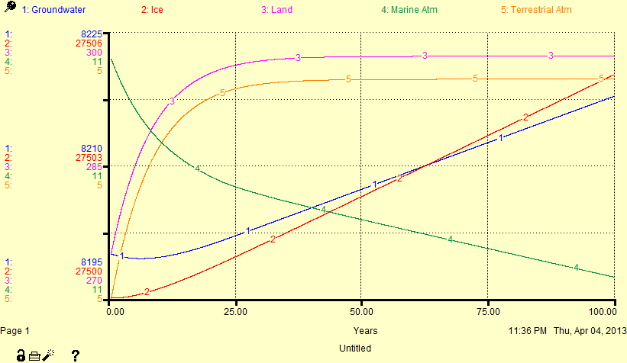
Experiment 1d: “All” human impacts

Slide 17
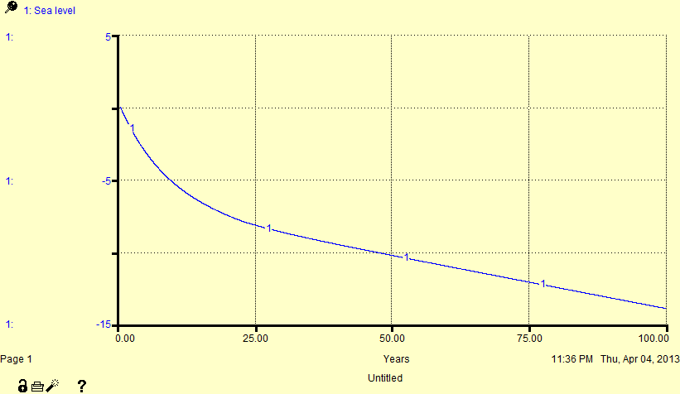
Experiment 1d: “All” human impacts

Slide 18
Experiment 2: Impact of changing climate
We have to refine the model to account for complex feedbacks. For example, in the initial model melt rates and evaporation rates didn’t depend on temperature.
Modification 1: Make global temperature depend on the total amount of water vapor in the atmosphere. The relationship is logarithmic because the greenhouse effect becomes weaker as the greenhouse gas concentration increases.
Modification 2: Define a temperature feedback that will be used to modify the various flows if the temperature changes from its initial value.
Modification 3: Change the evaporation flows so that they depend on the temperature feedback.

Slide 19
Experiment 2: Impact of changing climate
Modification 4: Have ice melting scale with the temperature feedback raised to the second power. (It depends more strongly on temperature than evaporation.)
Modification 5: Make snow and rain over land depend on the temperature feedback.
Modification 6: Modify stream flow to account for the fact that the land/soil has a limited surface capacity. If the amount of water stored on land gets too high, flooding will occur and stream discharge will dramatically increase.

Slide 20
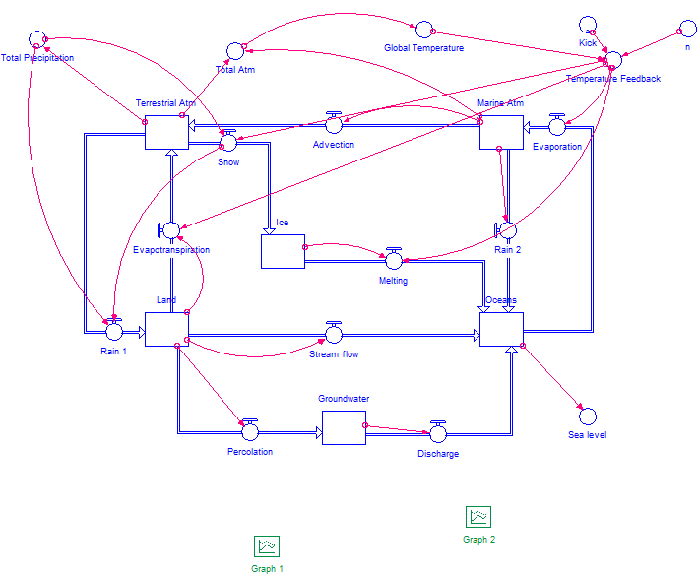
Experiment 2: Impact of changing climate

Slide 21
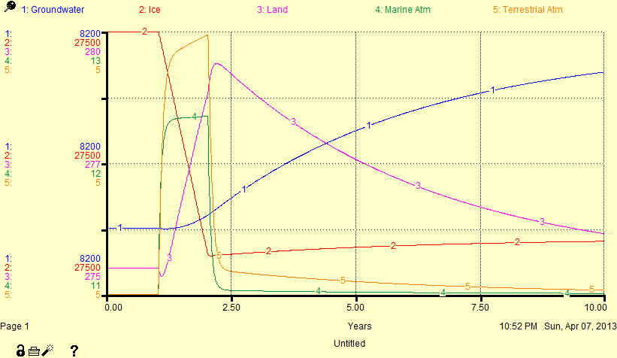
Experiment 2a: Brief warming event (1 Kelvin for 1 year)

Slide 22
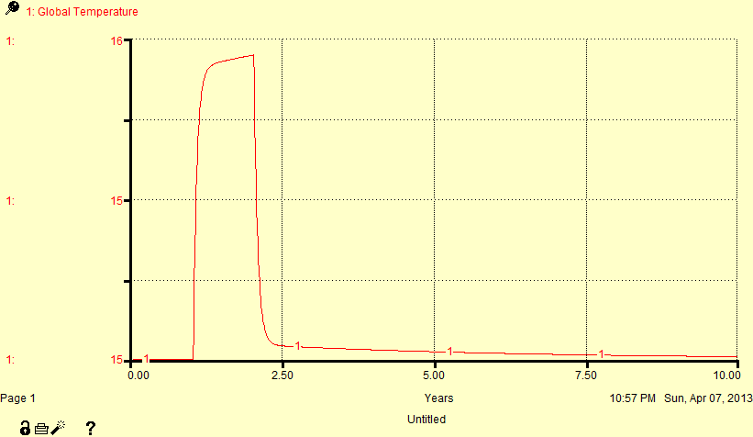
Experiment 2a: Brief warming event (1 Kelvin for 1 year)

Slide 23
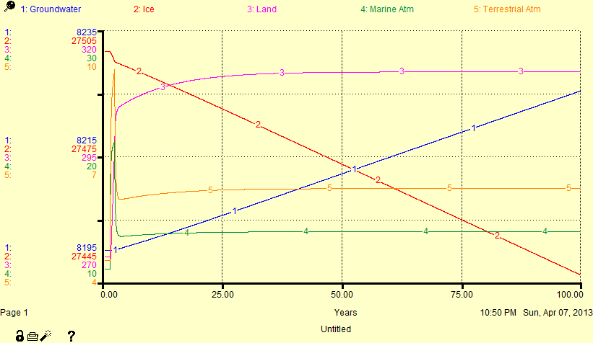
Experiment 2b: Brief warming event (1 Kelvin for 1 year), but with stronger temperature feedback

Slide 24
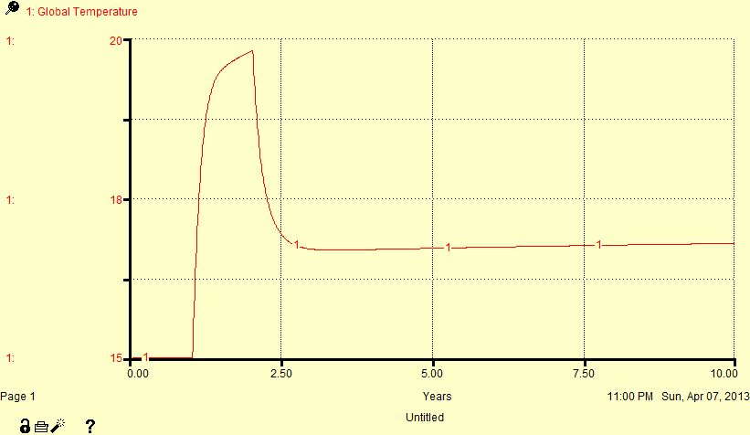
Experiment 2b: Brief warming event (1 Kelvin for 1 year), but with stronger temperature feedback

Slide 25
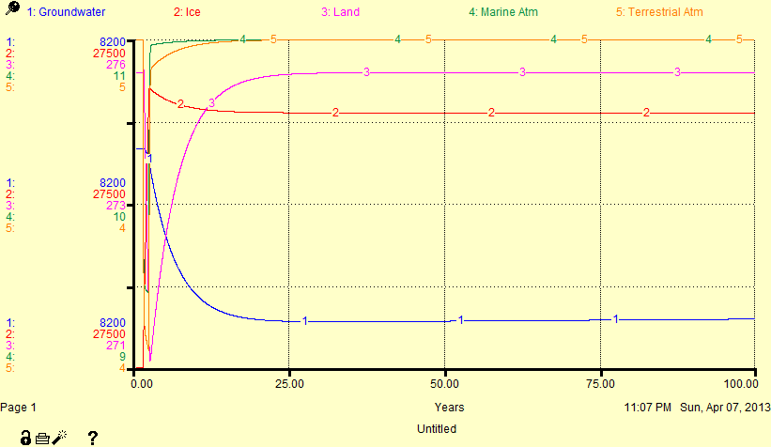
Experiment 2c: Brief cooling event (-1 Kelvin for 1 year)

Slide 26
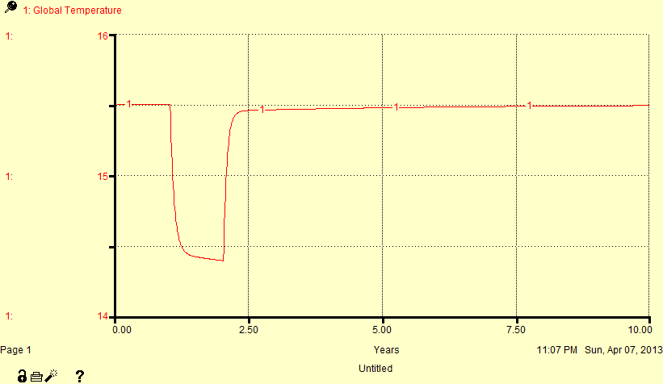
Experiment 2c: Brief cooling event (-1 Kelvin for 1 year)
Note: if the temperature feedback is too strong, this quickly turns into “Snowball Earth”.

